Slide 1

Swanalytics Churn Analysis: Swan Teleco
James Allen, Graciela Diwa, Harry Webber
Swanalytics specialises in data analytics and churn analysis, helping clients to increase customer retention by providing predictive modelling solutions to guide marketing strategies.
We would like to thank Swan Teleco for the opportunity to collaborate with the company on this churn analysis project.
Project Aims:
Understand demographic of churners
Recommend one factor to incentivise for new sign ups
Churn analysis to provide a list of Top 500 to mail
Churn risk of remaining customers

Slide 2
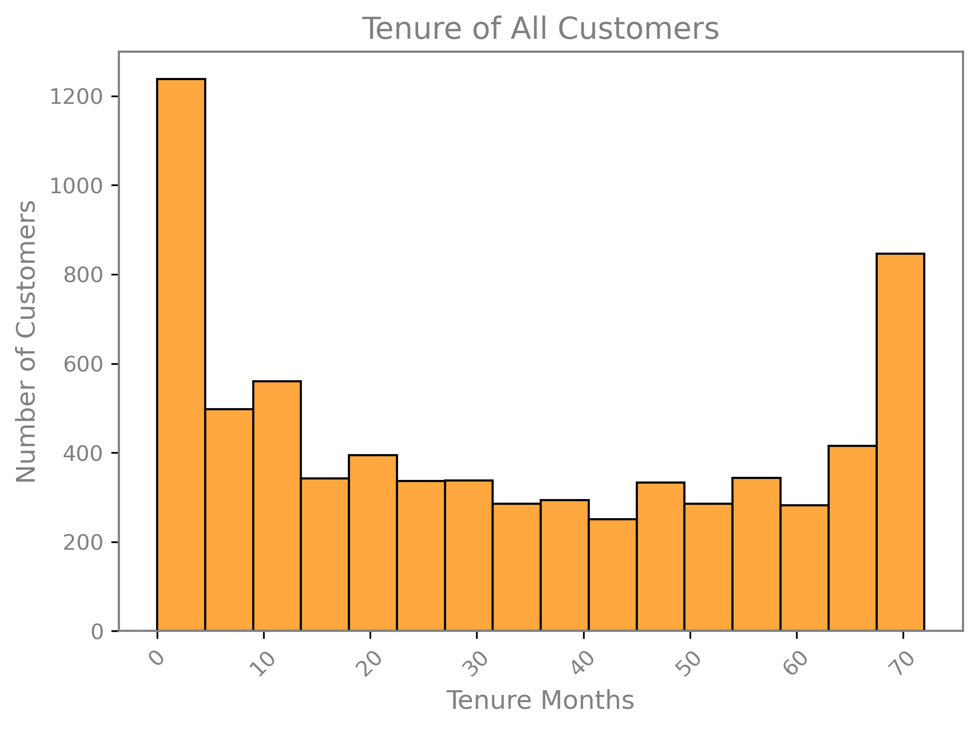
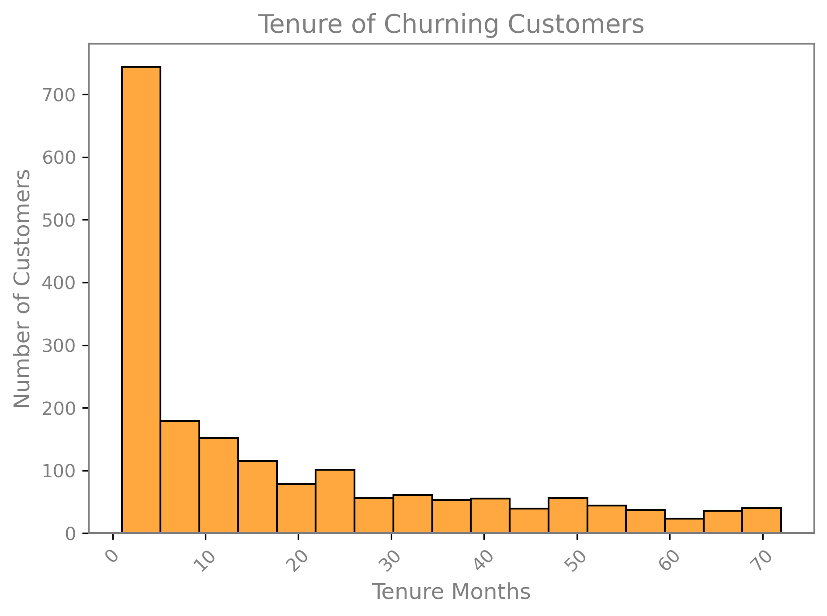
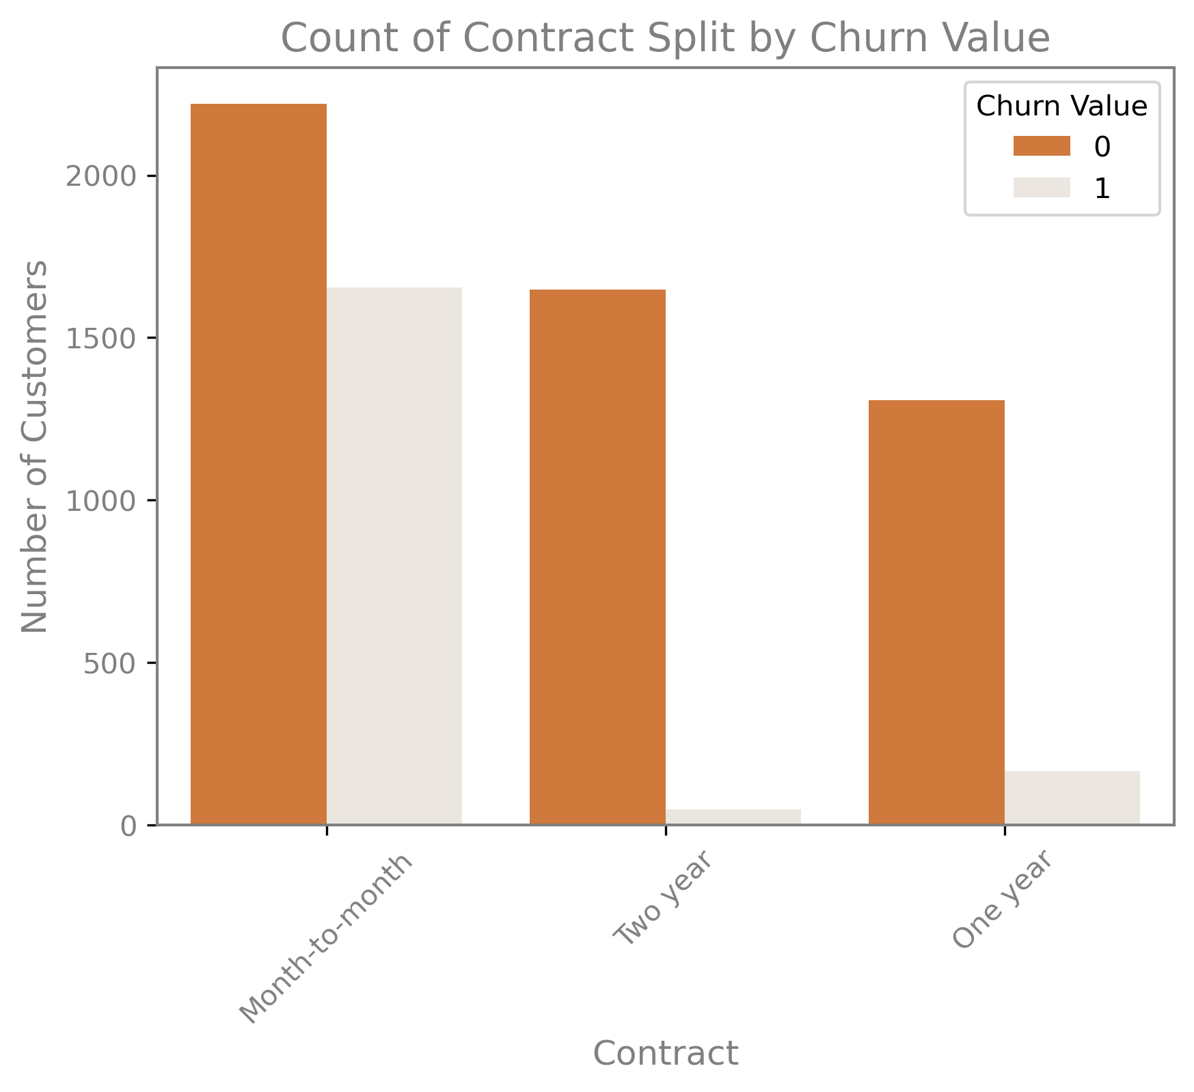
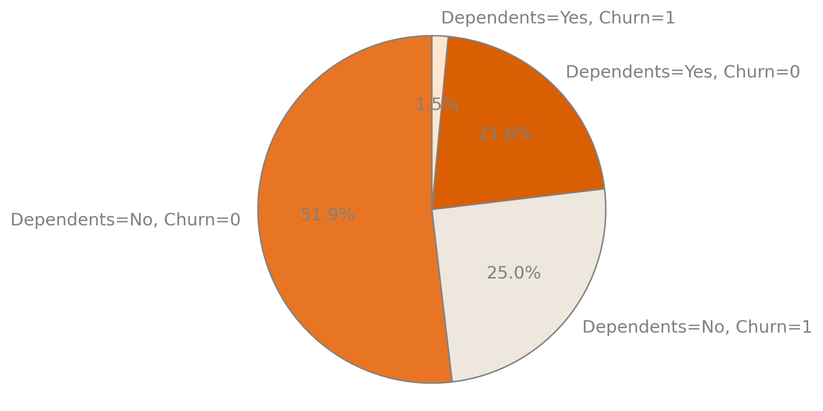
Key Info and Demographics
Correlation between Churn Value and Tenure Months: -0.352 (3 d.p.)
Customer Contract and Tenure
One of the first things that we identified during our exploratory data analysis was that the number of months of tenure has a notable negative correlation (-0.352) with whether a customer has churned. As tenure increases, fewer customers churn. This led us to investigate the distribution of customers by the tenure of their contract with the company.
The graphs to the right show a clear pattern in the tenure of churning customers. There are large number of customers who leave the company before their contract has lasted 5 months. In fact, of the customers who have churned - nearly 40% of them did so within the first 5 months. This was 744 of the total 1869 churning customers based on the dataset provided.
This aligns with the fact that very few customers who left the company held a two-year contract; in contrast, almost half of those who were listed in the dataset as being on a month-to-month contract have left the company [see graph below].
Demographics of Churning Customers
Based on what we have just explained about tenure, we could advise that you should encourage customers to stay with you for longer and encourage staff (members of sales teams) to sign people up to longer contracts - and you absolutely should! … but this is quite obvious, so we also decided to investigate some of the other identifiable patterns and demographics common among churning customers.
One other key criterion that has a significant impact on whether customers churn is whether they have dependents or not. We found that around ⅓ of people with no dependents had left the company whilst fewer than 10% of customers who do have dependents had churned [see pie chart - right].

Slide 3
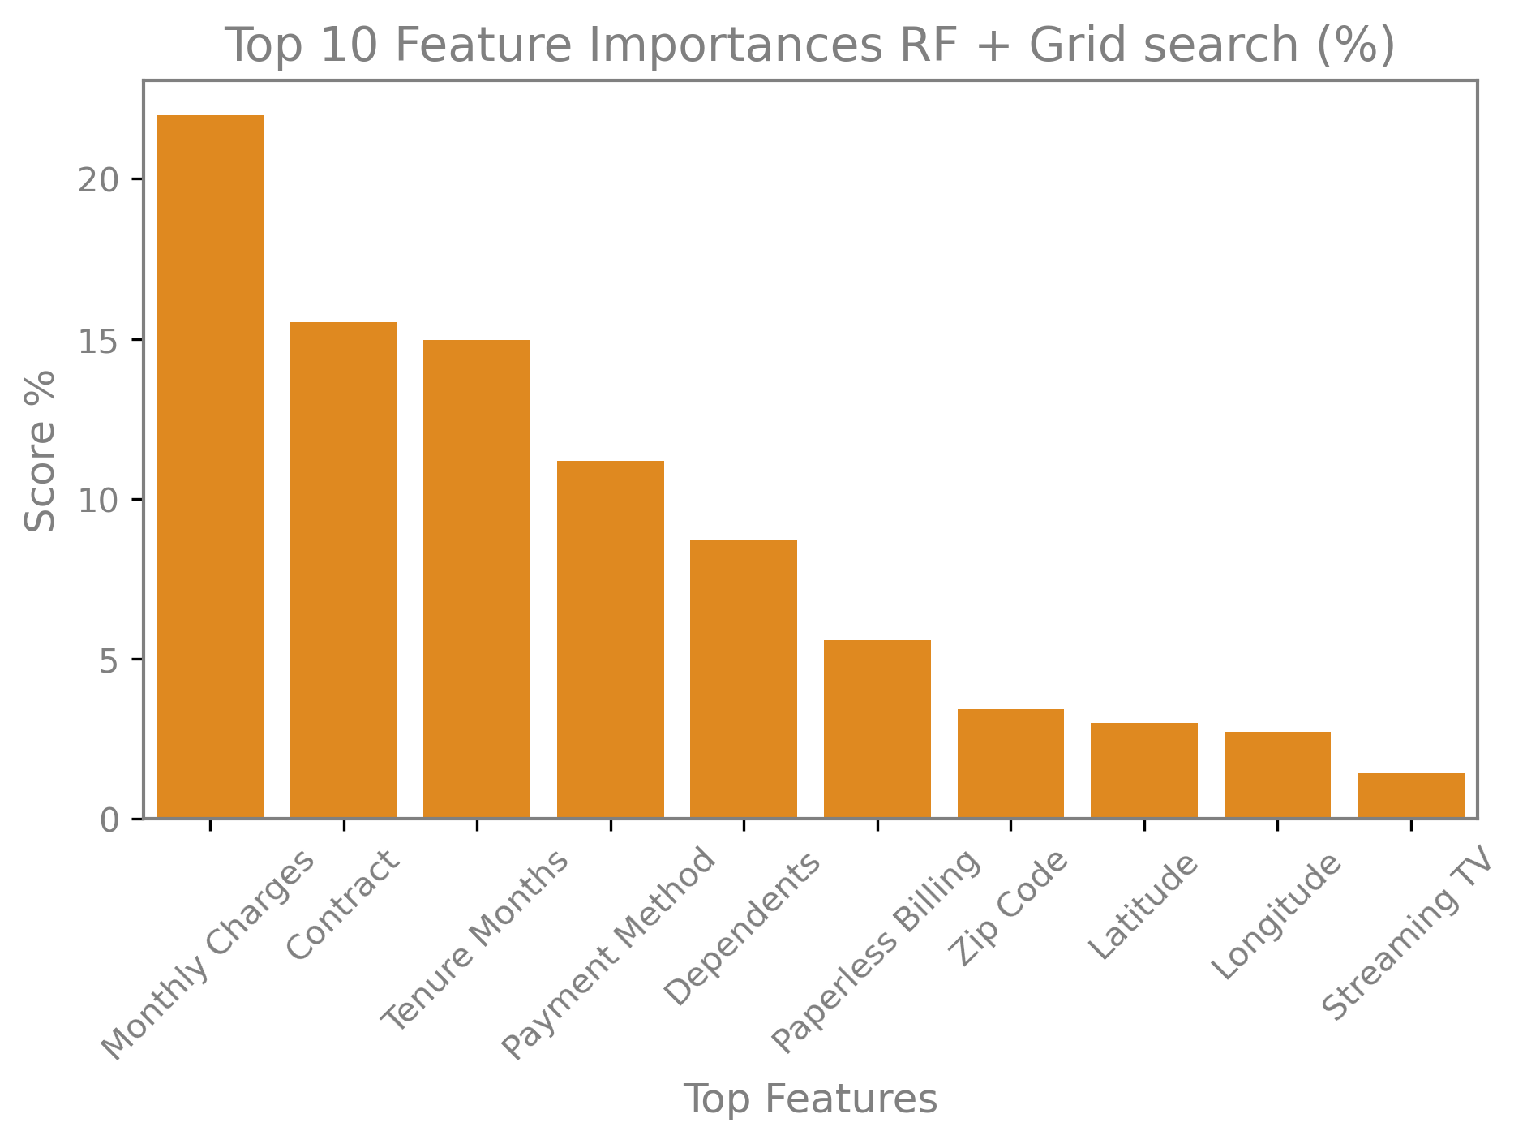
Predictive Modelling
Random Forest
Logistic Regression
With a limited spot of just 500 Customer IDs to send to the marketing team, it was essential that as many ACTUAL churners were captured by the model. This signalled that precision and recall were key metrics for evaluating our model.
Random Forest (RF ) was used in order to predict churners. This ensemble method attempted to increase accuracy and minimise overfit - whilst maximising precision and recall, with F1 being the harmonic mean of the two.
Grid Search was also applied to the RF to systematically optimise hyperparameters as well as nudging the model with parameters like class_weight=’balanced’ and scoring=f1 to extract performance.
This was essential when seeking to balance recall and precision. Over a series of iterative trials, this final model was produced and use to create a prediction of likely churners.
A logistic regression was used to predict the likelihood that a given customer would churn. Due to the nature of this we decided that we wanted to maximise precision whilst keeping the other metrics at a strong level. This means that that the top 500 we predicted are more often than not correct allowing the sales team to really focus on keeping these customers within the business.
As per the table below the features with the higher coefficient (the ones which influence the model with the largest impact.) are dependants followed by the contract lengths. If the sales team are able to push people into longer contracts this will reduce the churn rate of customers leading to higher revenue.
Since logistic regression is a linear model with low variance and higher bias, it is less prone to overfitting when compared to decision trees and random forests. This is reflected in the more consistent scores on the metrics across training and test data.
The feature importances of the model suggests that monthly charges, contract and tenure months are important to consider when predicting which customers will churn.
Logistic Regression Top 10 Important Features
Coefficient | Feature
1.53 | Dependents
1.20 | Contract_Two year
1.14 | Phone Service
0.69 | Contract_One year
0.51 | Online Security
0.50 | Tech Support
0.33 | Paperless Billing
0.32 | Payment_Method_Electronic check
0.31 | Partner
0.29 | Online Backup
Random Forest (+GridSearch) Key Metrics
 | Train | Test
Accuracy | 0.82 | 0.78
Precision | 0.62 | 0.53
Recall | 0.87 | 0.76
F1 | 0.72 | 0.63
Logistic Regression Key Metrics
 | Train | Test
Accuracy | 0.81 | 0.81
Precision | 0.67 | 0.64
Recall | 0.59 | 0.57
F1 | 0.63 | 0.60

Slide 4

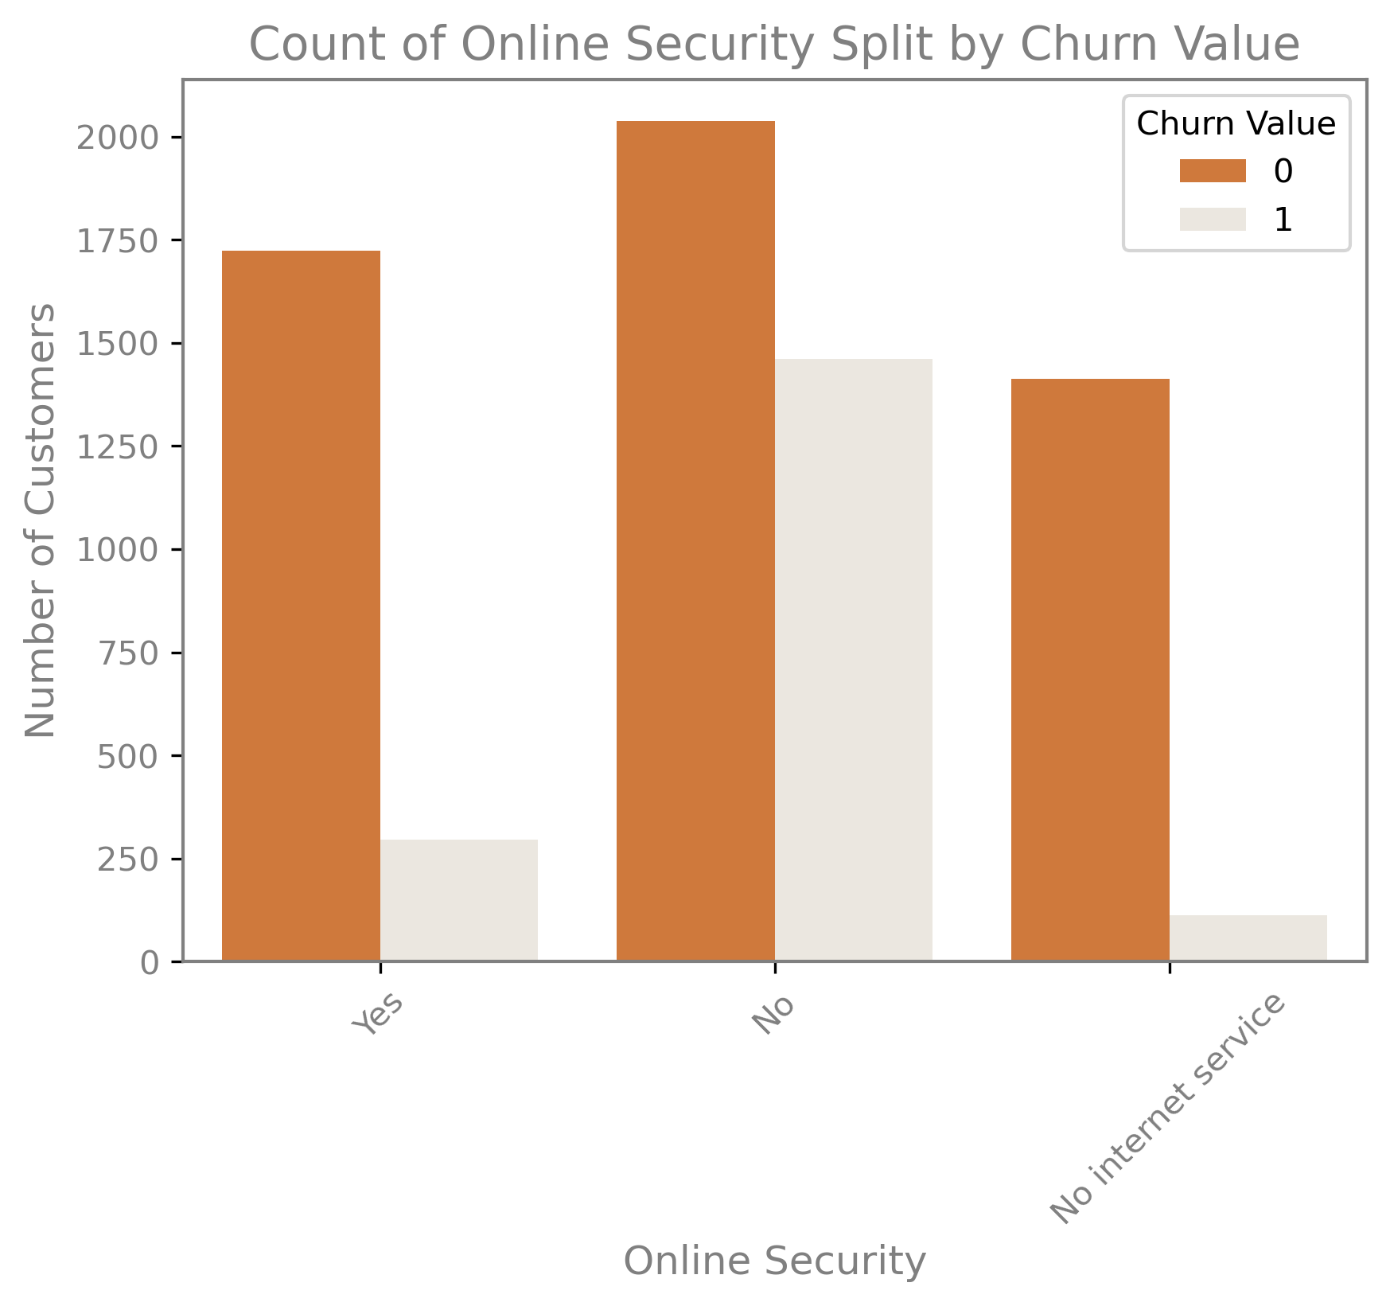
Factors that affect customer churn
Churn Reason | %
Attitude of support person | 10.27
Competitor offered higher download speeds | 10.11
Competitor offered more data | 8.67
Don't know | 8.24
Competitor made better offer | 7.49
Attitude of service provider | 7.22
Competitor had better devices | 6.96
Network reliability | 5.51
Product dissatisfaction | 5.46
Price too high | 5.24
Other reasons | 24.82
When a customer leaves the service, they are asked why they left. This table shows us some of the main reasons. We can identify from the table that a large number of responses were associated with actions of market competitors to the company. Approximately one third (33.23%) explicitly stated that their reason for leaving was a direct result of comparison with a competitor, including: higher download speeds, more data, better devices or a better offer. Whilst this is clearly an area that the company could address, this would mean fundamental changes to the services and/or pricing strategy.
There are also a number of leaving survey respondents who cited attitude of support people or service provider as a reason for leaving - this may suggest that additional customer service training for support teams would be advisable in lowering the churn rate. The other stated factors for customers leaving include network reliability and pricing, which again are potential areas that could be addressed from an operational standpoint.
Factors to Incentivise
These are factors where we found a difference in churn of customers. We found that uptake of these factors meant that customers were less likely to churn.
Longer contracts *
Online Security *
Opting for DSL over Fiber Optic
Online Back Ups
* In the graphs to the right, we can see that there is the greatest difference in churning between customers with Month-to-month contracts vs customers with One year or Two year contracts. As previously mentioned, these longer contracts can be something that sales staff encourage customers to sign up to.
In terms of an actual service or product to incentivise, adding an Online Security package greatly decreases the likelihood that a customer will churn. As a product it will contribute to Swan Teleco’s revenue, and it also has the added influence of reducing churn of existing customers.

Slide 5
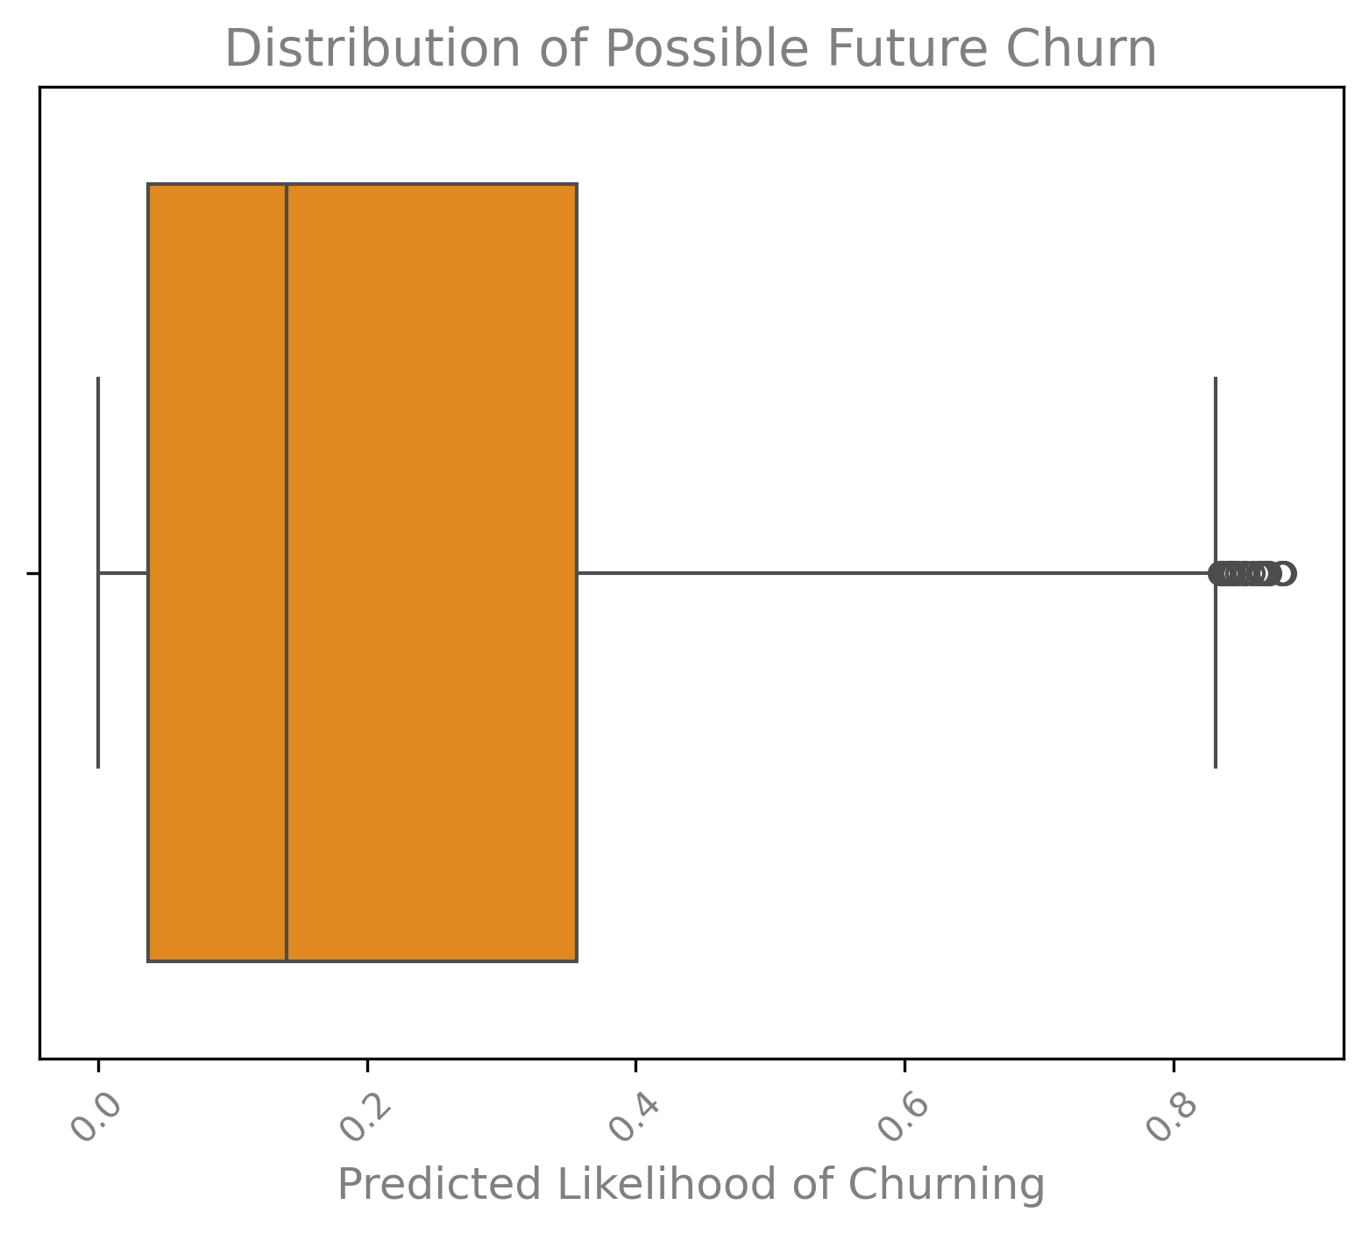
Predictions
The Top 500 at risk of churning (those we have suggested for mailers) was obtained by using a combination of the the two models, selecting customers who had the highest probability of churning based on our models. Out of these 500 customers, a summary of their churn probabilities is shown below…
The lowest probability : 59%
The mean probability: 70%
The highest probability : 88%
These figures have come from a mean average of a logistic regression model and a random forest model. We decided to use a combination of the two models to make our output more robust and thorough, which should ultimately lead to reduced errors in the predictions.
We produced a box plot of the distribution of predicted future churn probability for remaining customers. The plot is right tailed, which means that there is a higher concentration of customers with lower probabilities of churning. In the table below the same can be seen by looking at the percentage of customers in the low category compared to the other two.
Churn Risk Groupings (Low, Medium, High)
When we examined the predictions for future customer churn risk, we split them into 3 different categories. The top 500 we have defined as our ‘High Risk’ customers. These are the ones which should be targeted with specific products and deals in order to keep them.
The ‘Medium’ category is any customer above 30% risk of churning who is outside of the top 500. These are customers which are at a reasonable risk of churning in the future and should be monitored for business reasons. It would be advisable to take actions to maintain the loyalty of these customers moving forward; however this is not as much of a pressing issue as the high churn risk customers.
Finally there is the Low category. This is where most of the customers sit and they are the ones who are happy with the service they are being provided and are showing little to no sign of leaving any time soon.
All customers split into risk of churning categories
 | Amount | Percentage
High | 500 | 9.66%
Medium | 1073 | 20.74%
Low | 3601 | 69.60%

